Slide 1
Machine Learning
With tensorflow

Slide 2
What is Machine Learning?
Learning From Experience

Slide 3
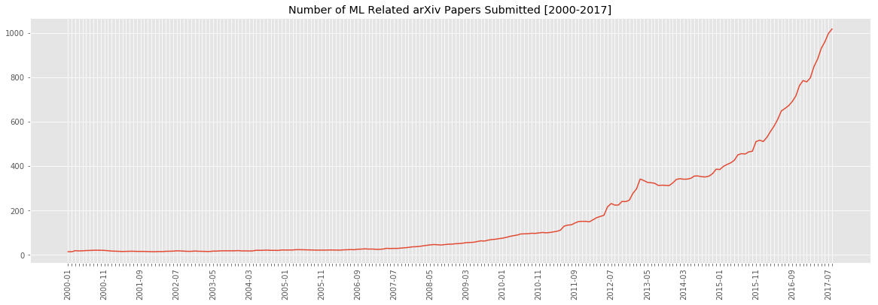
Why are People Excited?

Slide 4
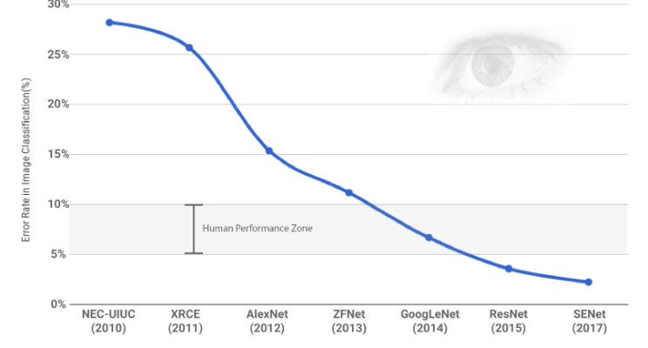
Human Level Vision (on some tasks…)

Slide 5
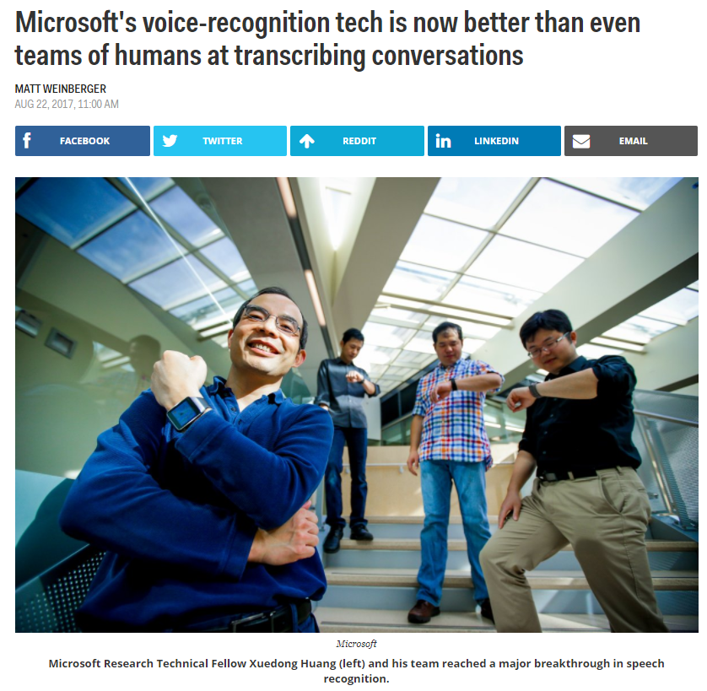
Human Level Speech to Text

Slide 6
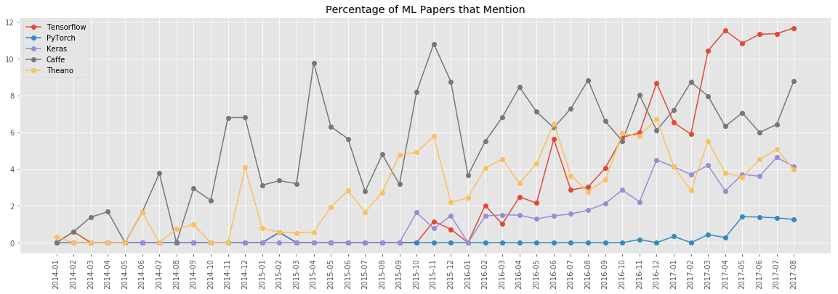
Python and TensorFlow

Slide 7
LeNet
The ‘hello world’ of Machine Learning

Slide 8
Resources
Stanford CS231N Course (videos + Assignments) http://cs231n.stanford.edu/
Deep Learning Book http://www.deeplearningbook.org/
Andrew Ng’s new course https://www.coursera.org/specializations/deep-learning
GitHub for this workshop http://github.com/maitchison/tf_workshop
Deep Visualisation Toolkit https://www.youtube.com/watch?v=AgkfIQ4IGaM

